Slide 1


A、 Introduction to research content:
My doctoral research topic is environmental perception and interaction of autonomous driving and robots based on deep learning. Specifically, algorithms such as sensor fusion, Transformers, NAS, large model Semi-Supervised Learning, and model compression and distillation are used to achieve 2D/3D target detection and tracking, scene segmentation and other machine vision and information interaction tasks.
My team and I are committed to researching the cutting-edge technologies of artificial intelligence and information interaction. All relevant achievements have been published (currently being published) in the Top Journal of the Chinese Academy of Sciences in Computer Science and Engineering (such as TNNLS, IF: 14.255) and the International Top Conference on Artificial Intelligence (IROS, ICRA).
I have extensive teaching and research experience, and was once the youngest associate senior teacher in the history of my previous employer. I have a strong background in automotive technology and artificial neural network technology.
4/4

Slide 2
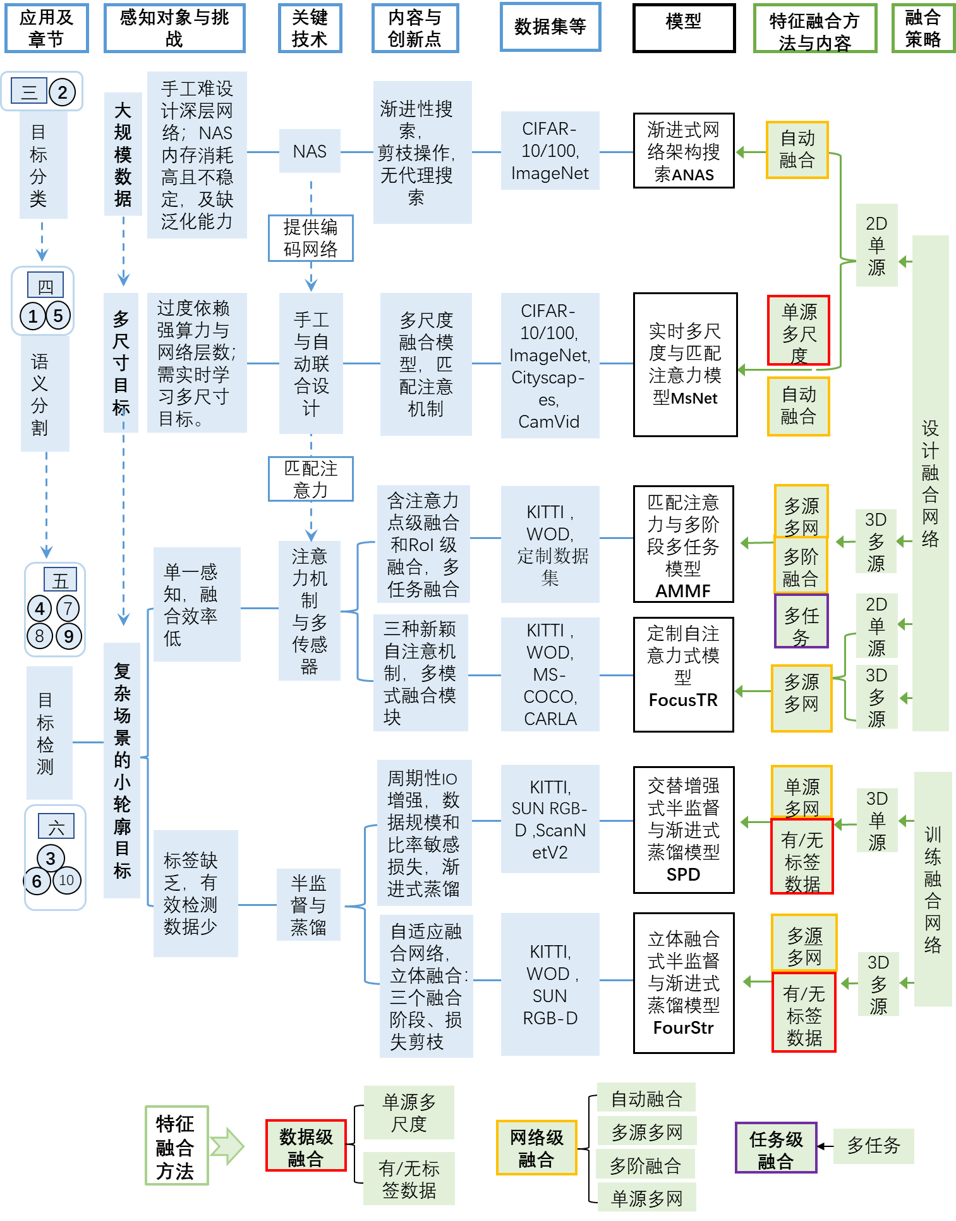
Research on Unmanned Driving Environment Perception
Based on Deep Learning Feature Fusion
(Design Overview of Doctoral Thesis)
The numbers in the left circle refer to 10 papers written by me as the first author;
This article proposes 6 efficient models, which have achieved excellent results on 9 mainstream publicly available datasets, 1 laboratory produced (mainly myself) unmanned driving complex scene CoSc dataset, and 1 urban driving simulator CARLA;

Slide 3
Autonomous driving: Intelligenced Vehicle Systems, Connected Vehicle Systems, Human Vehicle Interaction (HVI), HVI human factors and "Deep Orange" project.
Intelligent robots: Mobile manipulators, Natural Human-Robot Interaction (HRI), and multi robot systems (MRS).
B、 Laboratory practice content:

Slide 4
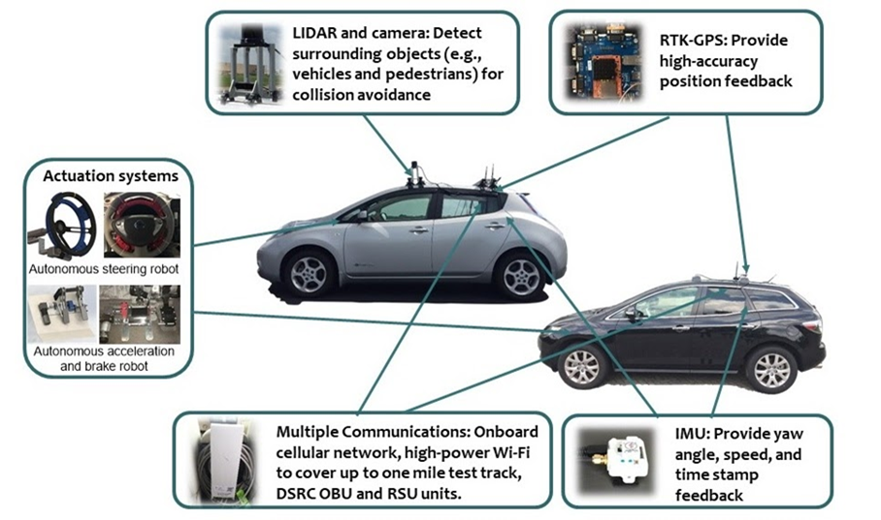
1. Autonomous driving
1.1 Intelligenced Vehicle Systems, IVS)：
The IVS is developing a novel modular, open-architecture, open-interface, and open-source-software based research instrument comprised of:
Augmented reality (AR) based simulation to facilitate Simulation- based-Design (SBD) of hardware and software
for a range of Connected and Automated Vehicle applications;
Physical real-time hardware-in-the-loop validation on a full-scale vehicle retrofitted with advanced sensing,
drive-by-wire, perception, connectivity, computation, and control modules.

Slide 5
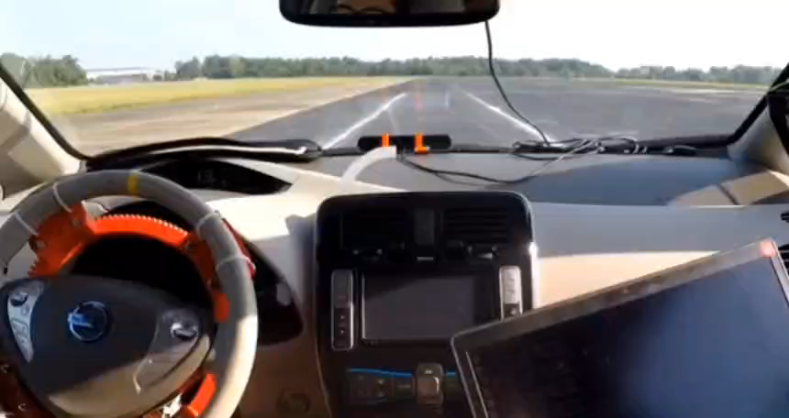
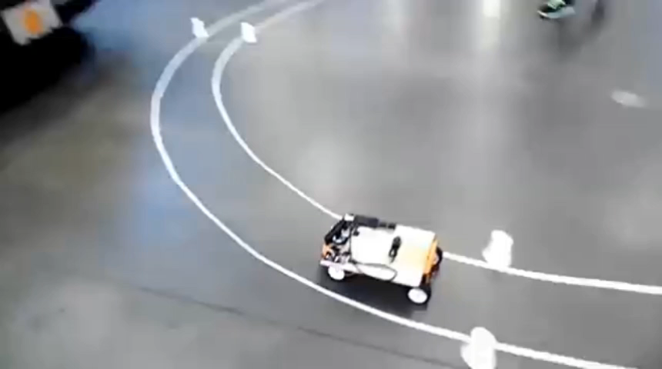
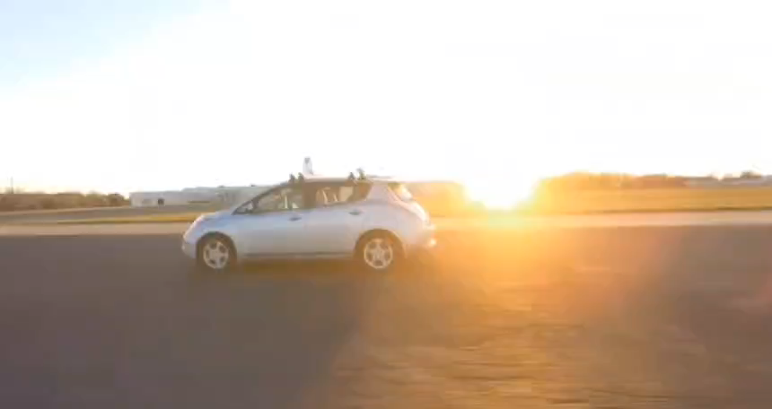

1.1 Intelligenced Vehicle Systems, IVS ：
（此页及之后PPT可以点击视频播放）
车辆智能化
车辆模型智能化（车道线检测）

Slide 6
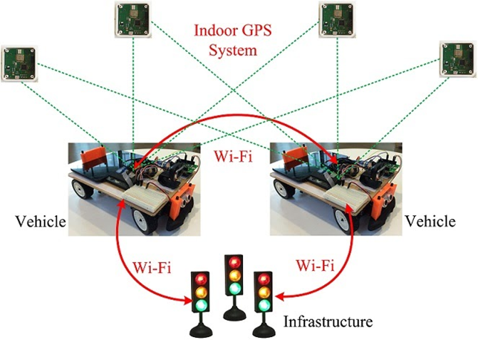
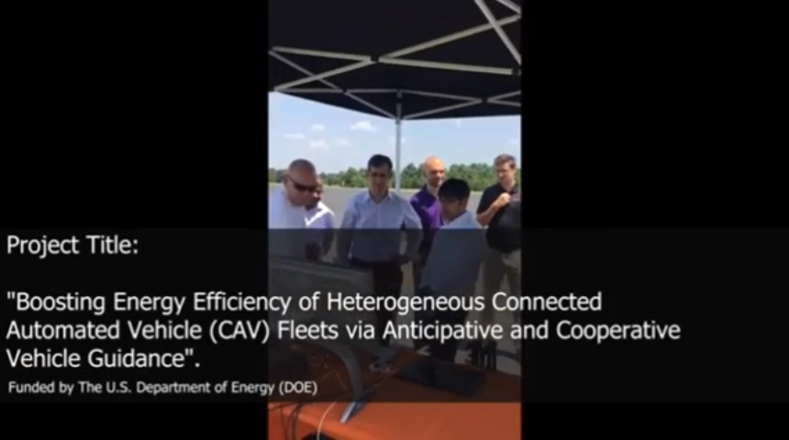
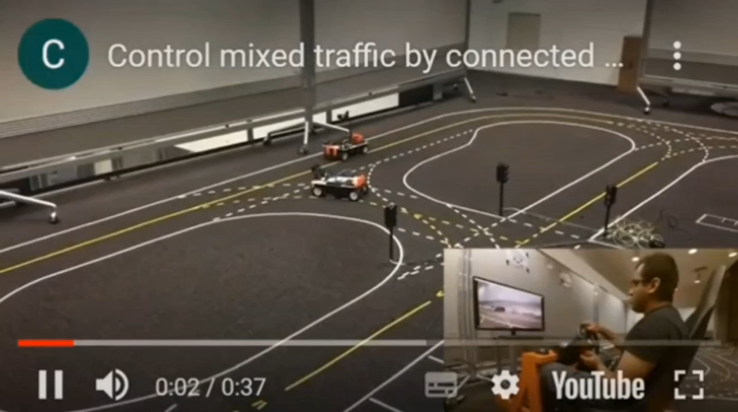
1.2 Connected Vehicle Systems, CVS · Energy consumption by connected vehicles · Planning and control mixed (auto vs. human) connected vehicles · Collaborative perception and sensing in connected vehicles
车对车通信
模型车辆通信

Slide 7
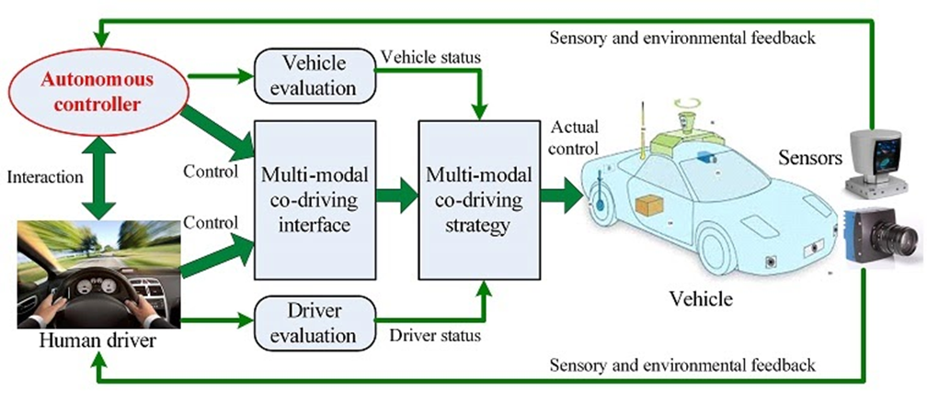
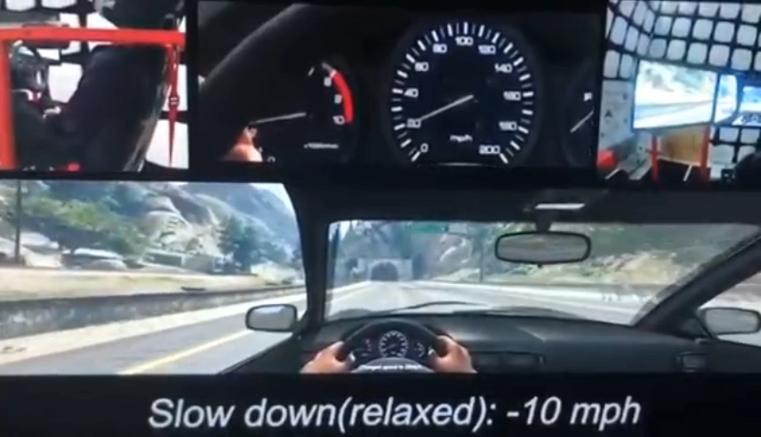
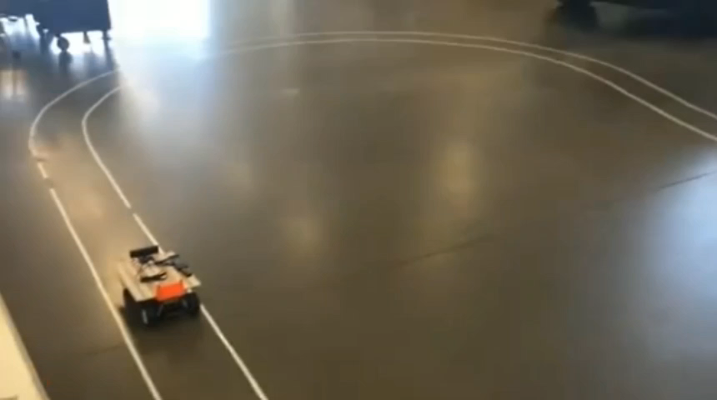
1.3 Human-vehicle interaction, HVI
· Modeling of human-in-the-loop autonomous driving
· Vehicle learning from human demonstrations
· Bilateral adaptation between humans and vehicles
语音交互
自适应学习

Slide 8
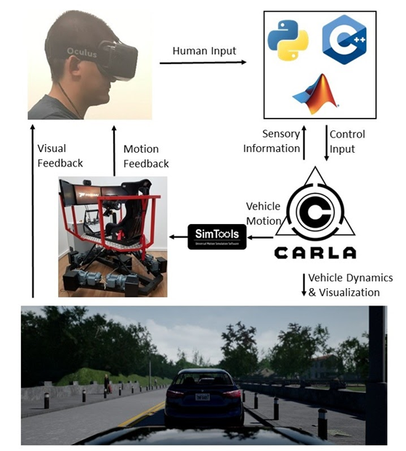
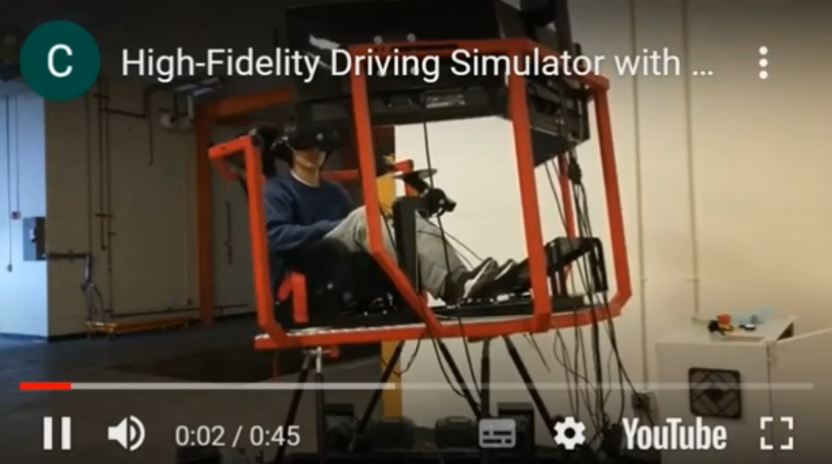
1.4 Human Factors in Human-Vehicle Interaction
· Modeling of humans in human-vehicle interaction
· Measuring of human affective states in vehicle riding

Slide 9
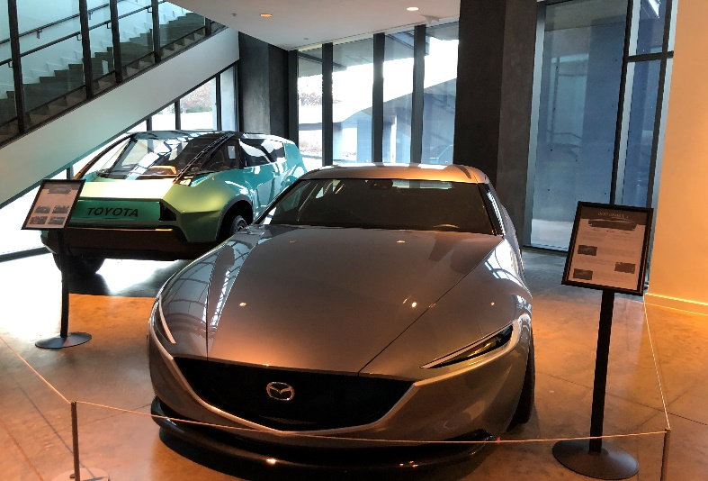
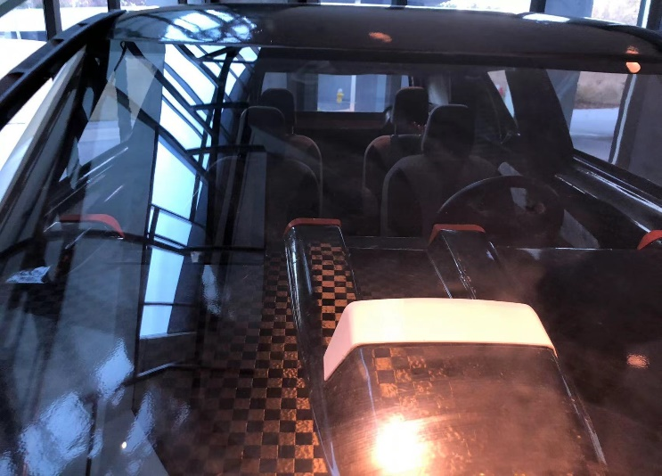
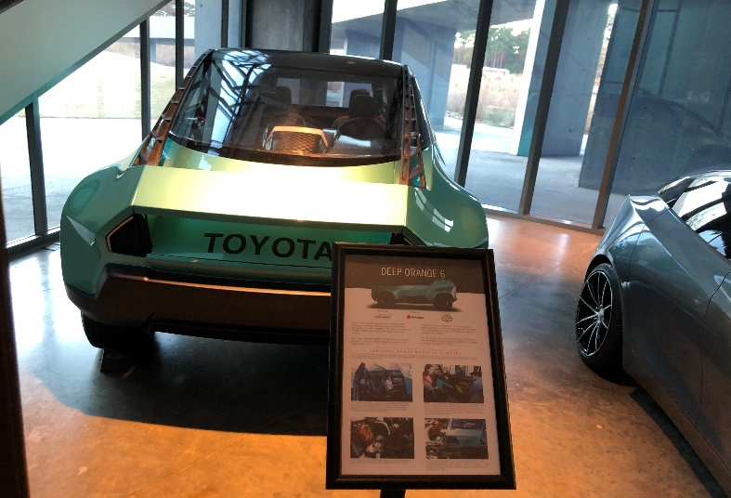
1. 5 “Deep Orange” project
Deep Orange 3
Deep Orange 3的内饰
Deep Orange 6
The famous CU-ICAR "Deep Orange" project publicly launches a concept car every two years). "Deep Orange" allows students to participate in the whole process of car design from the initial concept design to the final landing of the whole vehicle, providing automotive design (including the HMI design, body design, chassis design, etc.) and hands-on engineering experience. I am mainly responsible for the design, installation, and testing of traditional automotive sensors (various temperature and speed sensors, collision sensors, etc.) and intelligent driving perception sensors (cameras, LiDAR, etc.).

Slide 10
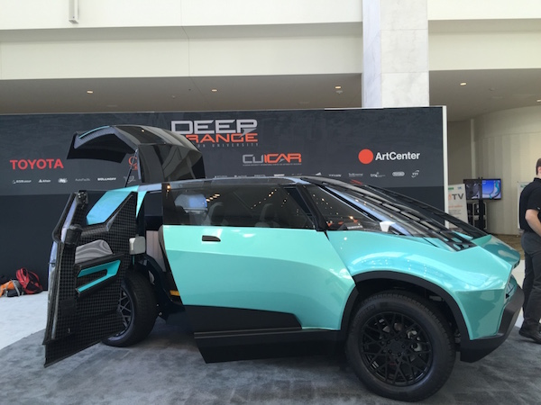
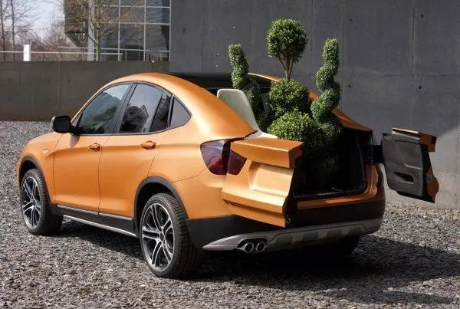
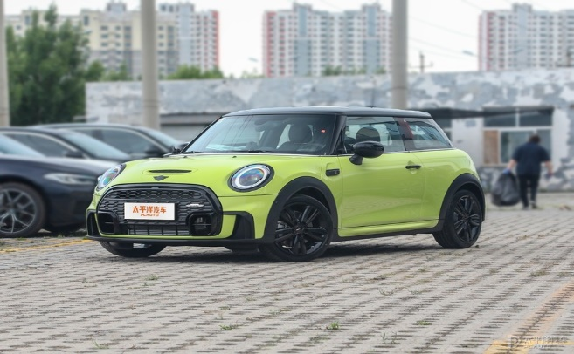
可百度搜索 “ Deep Orange项目” ： https://www.baidu.com/baidu?tn=monline_4_dg&ie=utf-8&wd=Deep+Orange%E9%A1%B9%E7%9B%AE
此三张图来自网络，此文档其它图片视频
均收集于本人境外实验室CU-ICAR。
Deep Orange 6 项目出产的第六款概念车，将由其合作方丰田进行投产。
2016/04/21。http://www.cheyun.com/content/10295/
3D打印重新设计制造宝马X3 SUV！
2018-03-19。 https://baijiahao.baidu.com/s?id=159533392235025
8677&wfr=spider&for=pc
DeepOrange7 概念试图改造复古Mini。
2022-07-29。https://baike.pcauto.com.cn/239109/453717.html

